Slide 1
Teacher : Nguyen Thi Thanh Loan
WELCOME TO CLASS 5 A3 !

Slide 4
Wednesday, November 9th, 2022
Unit 6
HOW MANY LESSONS DO YOU HAVE TODAY?
Lesson 2: Part 4, 5, 6

Slide 5
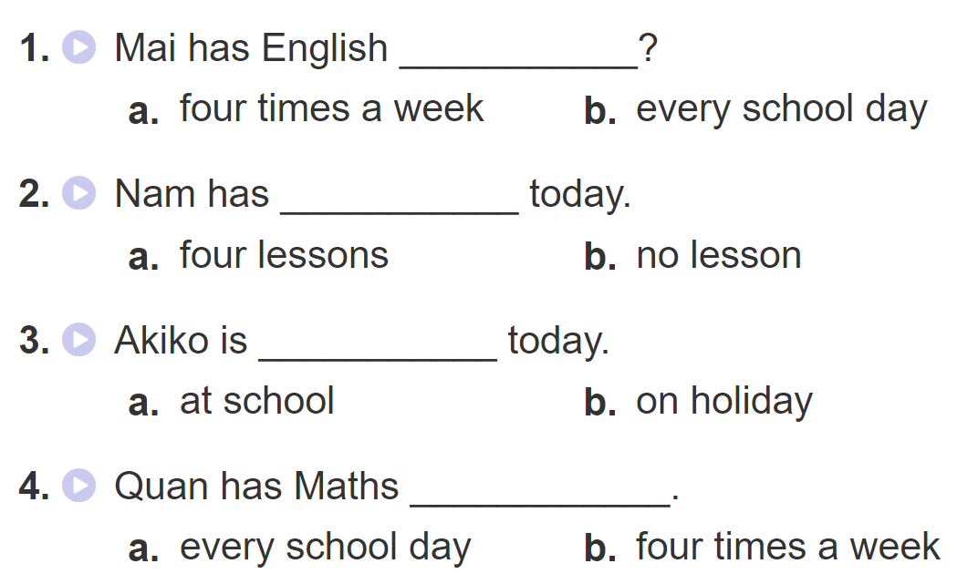
4. Listen and circle a or b

Slide 7
4. Listen and circle a or b

Slide 8
Question 1: How may lessons does Nam have today?
Question 2:How often does Mai have English ?
Question 3:Is Akiko on holiday today ?
Question 4: How often does Quan have Maths?

Slide 9
VÒNG QUAY MAY MẮN

Slide 10
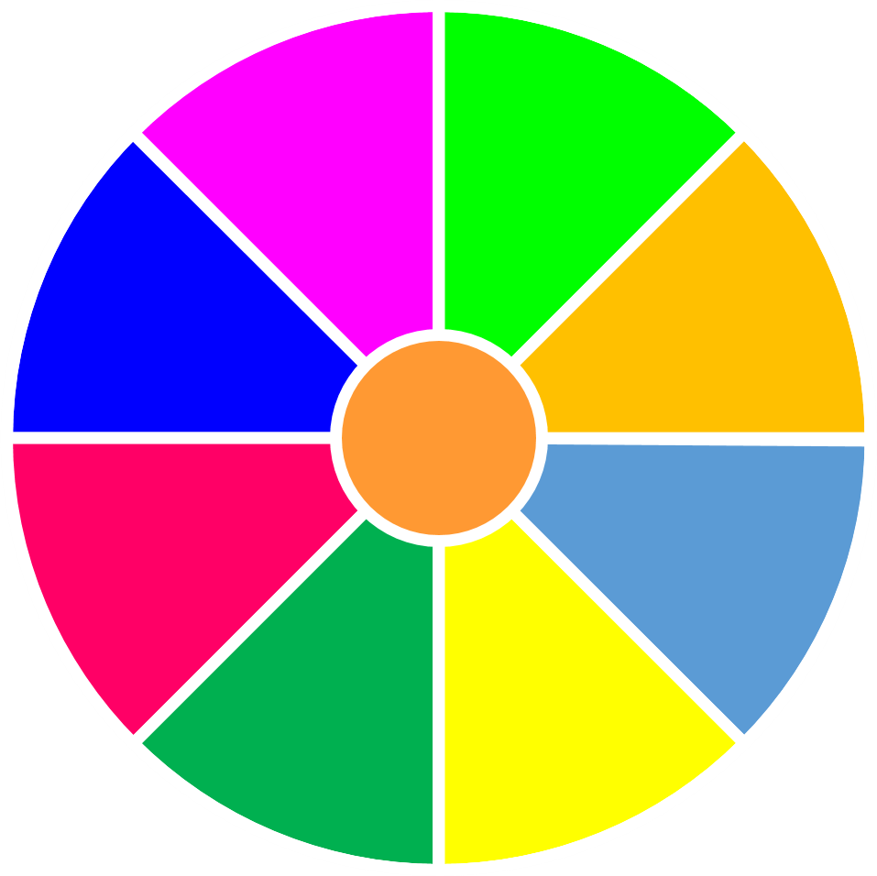
VÒNG QUAY
MAY MẮN
30
- 20
1
2
- 40
10
50
80
3
4
60
70
QUAY

Slide 11
Question 1: How may lessons does Nam have today?
A. He has five lessons
B. He has four lessons
C. He has six lessons
D. He has three lessons
QUAY VỀ

Slide 12
Question 2: How often does Mai have English ?
She has it four times
a week
B. She has it three times
a week
C. She has it twice a week
D. She has it everyday
QUAY VỀ

Slide 13
Question 3: Is Akiko on holiday today ?
A. No, she isn’t
B.Yes, she is
C. Yes, she isn’t
D. No, she is
QUAY VỀ

Slide 14
Question 4: How often does Quan have Maths?
A. every school day
B.four times a week.
C. once a week.
D. Three times a week.
QUAY VỀ

Slide 15
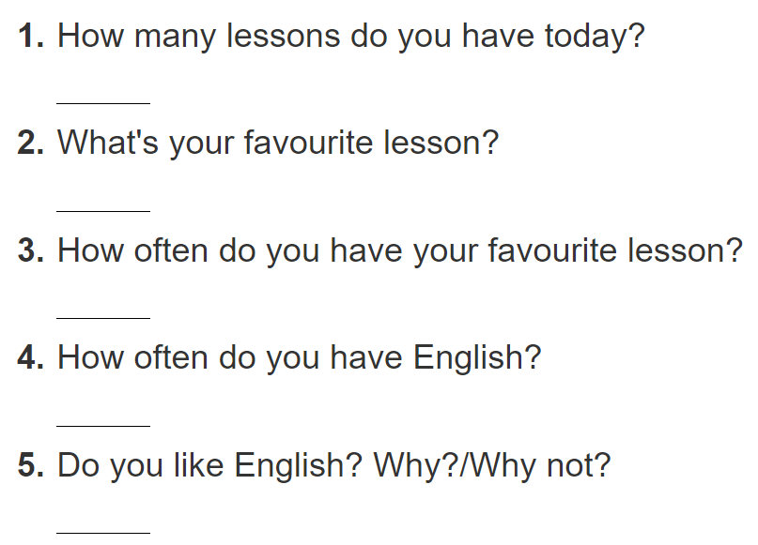
5. Write about you
I have ________________________.
My favourite lesson is/ It’s____________.
I have it ______________________.
I have it ______________________.
Yes, I do/ No, I don’t. Beacause ____.

Slide 16
5. Write about you
I have three: Maths, IT and English.
My favourite lesson is English/ It’s English.
I have it every school day.
I have it three times a week.
-Yes, I do. Because I can sing English song.
Because it is intersting.
- No, I don’t. Because it’s very difficult.

Slide 17
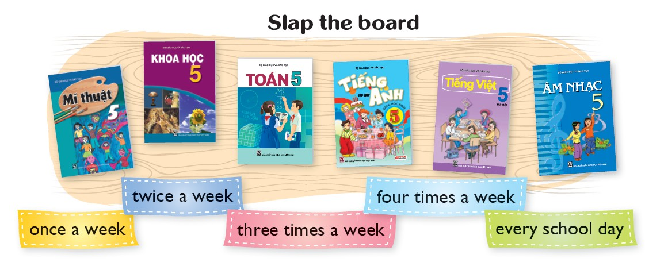
6. Let’s play

Slide 19
Write a paragraph about yourself based on activity 5 .
Ex:
My name is ……………... I’m in Class …………. Today is Tuesday, I have five lessons: Maths, Vietnamese, Art, IT and English. My favourite lesson is English. I have it three times a week. I like English because I want to be English teacher.
Do you like English?

Slide 21
Question 5: What subject does Quan like best?
A. He likes English
B. He likes Maths
C. He likes Art
D. He likes Music
4
QUAY VỀ

